Slide 1


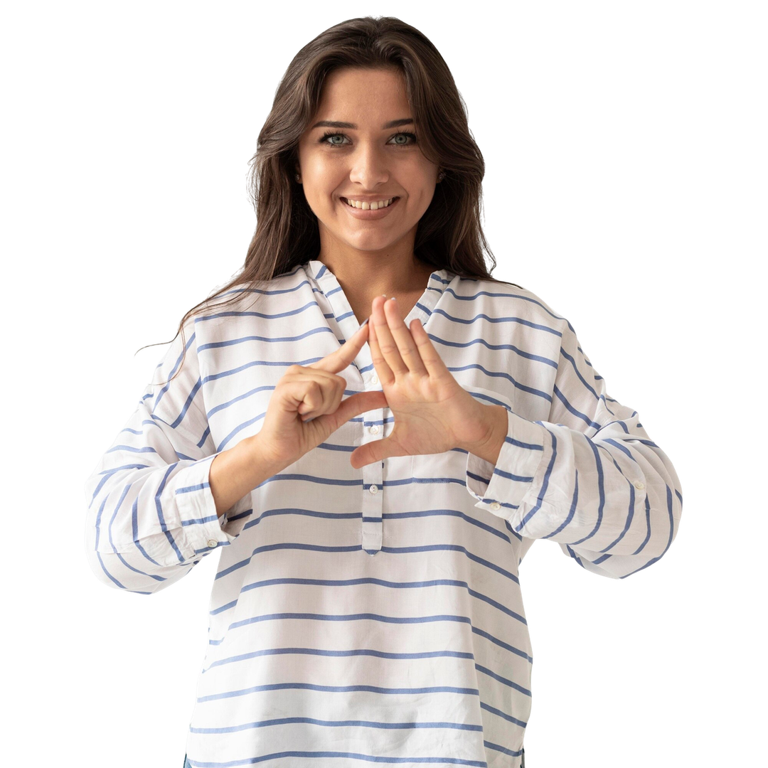
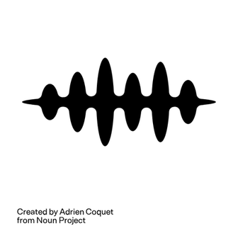




VOICELESS TO VOICE
Real-Time Indian Sign Language (ISL) to
Speech Conversion using Deep Learning
Guide: Dr. Brijbihari Dubey
BTECH CSE (DS) 7TH
BHANKALE YASH
KARANDIKAR SAKSHAT
SHINGOTE AMRUTA
MORE HIMANSHU

Slide 2
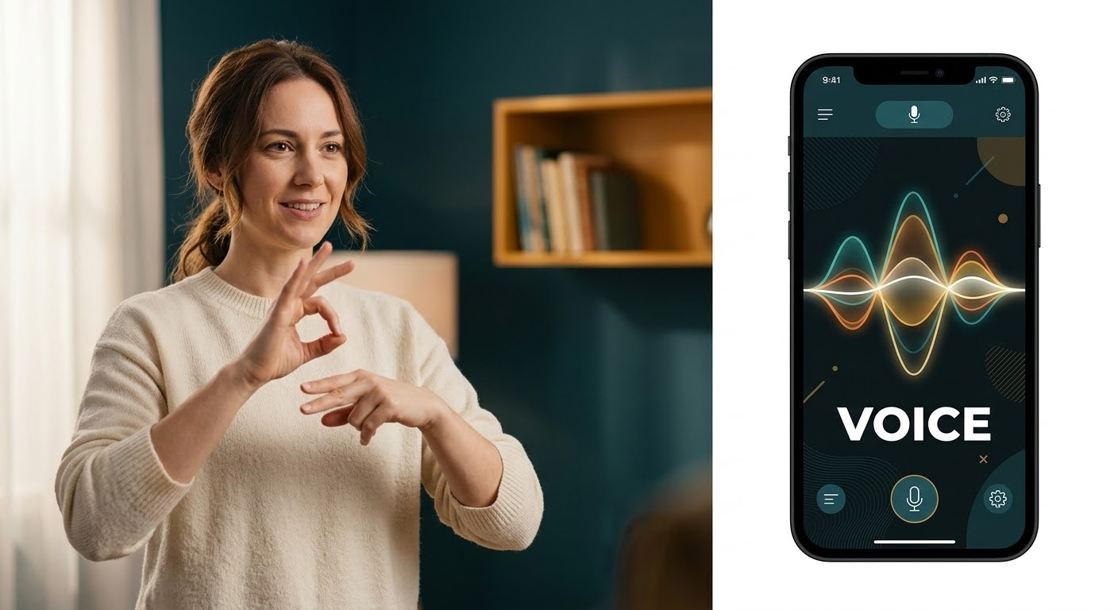



PAGE 02
THE SILENT BARRIER
Millions of individuals worldwide rely on sign language as their primary mode of communication, yet a massive gap exists between them and the hearing world.
    Scalability: Human interpreters are vital but are often expensive and unavailable for spontaneous, daily interactions.
    Hardware Constraints: Many existing digital solutions require bulky sensors or high-end processing power that isn't accessible to everyone.
    The Real-Time Gap: Current technology often solves the "recognition" problem but fails to provide the human element: instant, spoken feedback.

Slide 3















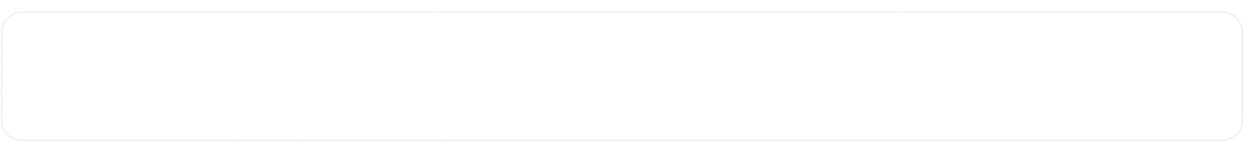
PAGE
03
SYSTEM OVERVIEW
How Does Voiceless to Voice Work?
End-to-end pipeline: gesture to spoken word in under 500ms
Webcam
MediaPipe
Frame Buffer
BiSTM+Attn
TTS Audio
30 FPS
138 Landmarks
60 Frames
<15ms
pyttsx3
30 FPS
<15ms
35
100%
Live Inference
Per-Frame Latency
ISL Classes
Offline Capable

Slide 4























ARCHITECTURE
PAGE
04
Full System
Architecture
A complete pipeline from training to real-time inference with a robust fallback strategy.
01
TRAINING PHASE
(Google Colab GPU)
02
INFERENCE PHASE
(Local Machine)
Dataset collection → 60-frame .npY sequences
Webcam → MediaPipe Holistic
Rolling deque(60 frames)
Upload to Google Drive (T4 GPU training)
PyTorch Model Inference
BILSTM+Attention → unified_sign_model.pt
Majority voting + Cooldown
Download model (~3MB) for local use
pyttsx3 TTS → Speaker

Slide 5


















DATA & FEATURES
PAGE 05
Dataset Collection &
Feature Engineering
MediaPipe Holistic Landmarks
Dataset Specs
Left Hand (21 keypoints × 3)
63
35
30+
Right Hand (21 keypoints × 3)
63
ISL Classes
Sequences/Class
Upper Pose (4 keypoints × 3)
12
60
~2s
Total: 138 features / frame
Frames/Sequence
Window Duration
Sequence: 60 frames × 138 = 8,280 values/gesture

Slide 6























DEEP LEARNING MODEL
PAGE 04
BiLSTM + Self-Attention
Neural Network
From gesture sequences to class probabilities using a deep neural network.
01
02
03
04
05
Input Layer
Linear(150→128) + BatchNorm1d + ReLU + Dropout(0.3)
Bidirectional LSTM
Self-Attention
Linear(256→128) + ReLU + Dropout + Linear(128→35) → Softmax
(Batch × 60 Frames × 150 Features)
2 Layers • Hidden=128 • Dropout=0.3
Out: 256–dim
Softmax over
60 time steps → Weighted context vector
Gesture sequence input from preprocessed landmarks.
Feature projection and normalization.
Captures temporal dependencies in both directions.
Focuses on the most relevant gesture frames.
Produces class probabilities for 35 ISL classes.
3000
A deep learning pipeline designed for accurate and real-time gesture recognition.
From Gestures to Meaning
ISL Classes
Powered by Deep Learning

Slide 7






WEB INTERFACE
PAGE
05
Gradio Web Dashboard &
ISL Vocabulary
Tab 1 — Video Translation
Tab 2 — Supported Vocab
Tab 3 — Architecture Info
Upload ISL video → Annotated output with landmark tracking & recognized sentence text
Full list of trained ISL sign classes displayed as interactive labels
Model specs, input dimensions, inference latency, and training details

Slide 8












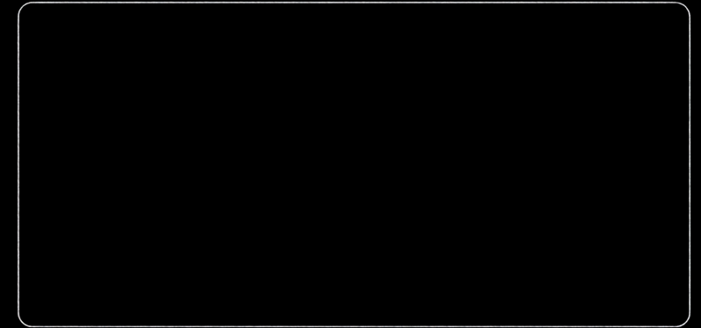

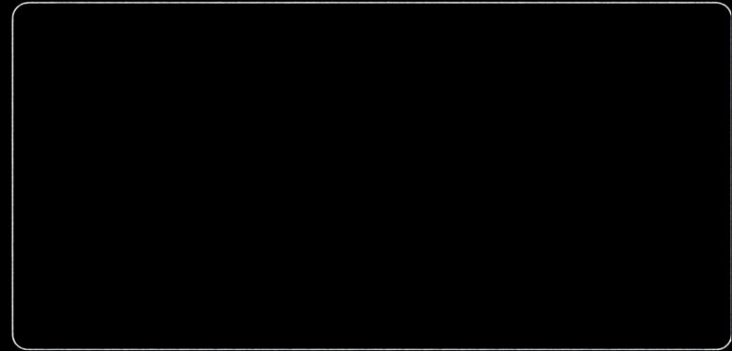








RESULTS & PERFORMANCE
Target Metrics &
PAGE
06
Performance Benchmarks
85%+
30 FPS
<0.5s
<5%
Min Val Accuracy
Real-Time Inference
TTS Trigger Latency
Idle False_Positive
Legacy vs. Unified Model
Colab vs. Local Inference
Random Forest + DTW (Legacy)
~72%
Colab + ngrok
Local Inference
≠85%
2–5 FPS
200–800ms lag
Needs internet
Crash risk
20–30 FPS
<10ms latency
100% Offline
Zero crash risk
BiLSTM + Self-Attention (Ours)
Ideal Target
92%

Slide 9




